Slide 1

Case Study

Slide 2

directory
01
04
variables to fit
model tuning
02
05
DATA preprocess
model evaluation
03
feature engeering

Slide 3

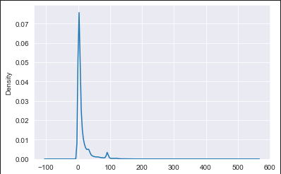
variables to fit
distinguish customers
The decision time between policy application date and policy close date can be used to distinguish customers.
Those who take longer time to decide might need further intervention.
The median of decision time(5 days ) is set as threhold. Records with decision time longer than 5 days are labeled as ‘1’ while the rest are lebeled as ‘0’.

Slide 4


Preprocess: Explore
Data1:
‘policy_pending_status’ has 4.5% missing data;
‘document_uploaded’ has 1.2% missing data;
‘product’ is the concatenation of multiple product codes
Data2:
‘policy_pending_code’ has 46.2% missing data;
date intervels has negative values;
Data3:
no missing data;
10% of ‘owner_or_insured’ has duplicate values;
‘owner_or_insured’ has non_numerial values

Slide 5
Preprocess: Cleansing & Merging
Data1
drop rows with missing values
Data2
drop rows with negative decision time
fill missing value of ‘policy_pending_code’ with ‘None’
Data3
drop duplicate id
drop rows with non_numerial values
Left join data2 with data1 and data3 to create a wide table.

Slide 6


Preprocess: Feature Engeering
OneHot Encoding
Month Encoding
Topic Model
days:
less than 5 days = 0, longer than 5 days = 1
policy_pending_status: FAILED = 0, PASSED = 1
document_uploaded:
FAILED-DCK = 0, PASSED = 1
...
For month in ‘policy_application_date’ and ‘policy_close_date’:
For product code and pending code, use latent dirichlet allocation decomposition to extract 5 features(‘topics’) each from them.
In topic model, each code(‘word’) is assoicated with different weight in ‘topics’ and each topic has different weight for different codes.
$$sin_enc = sin(\frac{month}{24π})$$
$$cos_enc = cos(\frac{month}{24π})$$

Slide 7
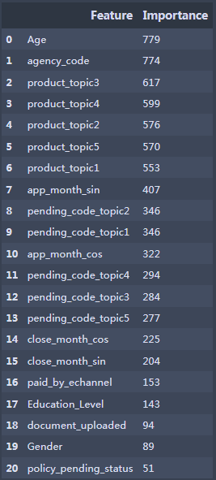
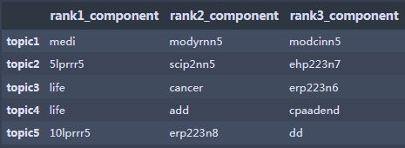
Model Tuning and Evaluation
* Employ lightGBM to perform binary classification
* AUC for training set = 0.88; AUC for testing set = 0.85
* Age and Agency are the most important features.
* topics extracted from Product code are also important .
* ‘LIFE’, ‘CANCER’, ‘ADD’are the most revelant codes in ‘product’

Slide 8
further improvement
* Topic numbers for product code and pending code can be further tuned;
* With the help of field knowledge expert, better embedding/decomposition of product code, pending code and even agent code might be possible;
* More features can be extracted from other raw features.
* LightGBM might be better tuned by auto-tuning packages such as HyperOpt .
* With the help of field knowledge expert, other target variable to fit might be engeered, and it might has better practical application than ‘decision time’.

Slide 9

Thank you!

